Slide 1
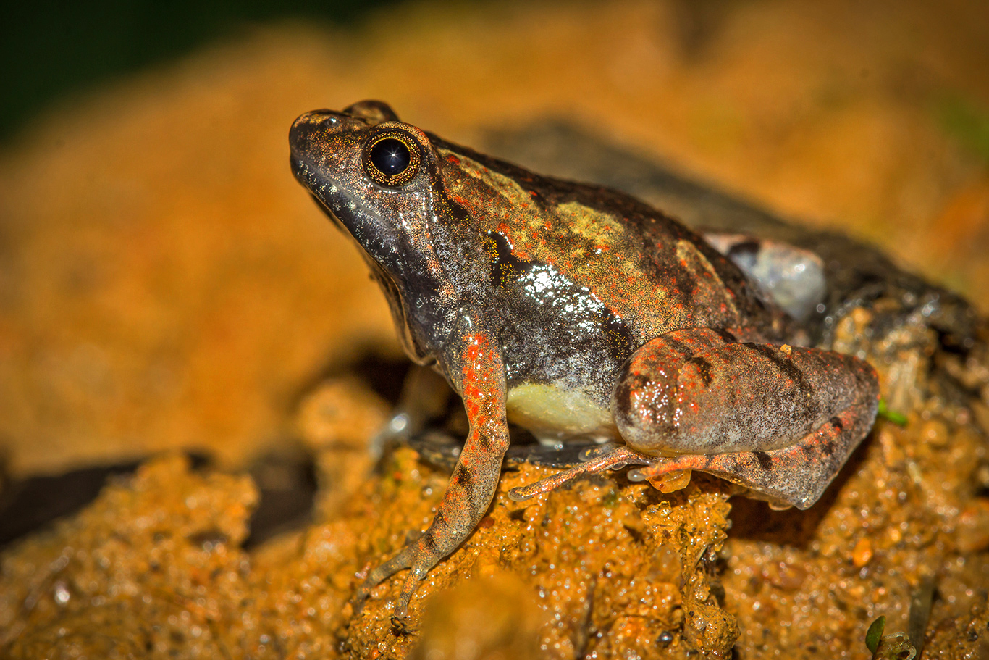
Citizen Conservation
Case Study-6
Limitations of traditional conservation measures and the role of technology in mitigating them
Laterite Narrow-mouthed Frog
Source: Ramit Singal
Notes:
The Laterite Narrow-mouthed frog was discovered at End Point in 2016 as a result of a citizen’s observations.
Additional Reading Material:
Case Study #16, page number 112 in the “environmental reader” textbook
https://www.wcs.org/get-involved/updates/wild-seve-celebrates-10-000-cases
http://www.conservationindia.org/campaigns/amur-massacre
https://birdcount.in/amur-falcons-from-russia-to-africa/
Prepared by Shaurya Rahul Narlanka

Slide 2
The Laterite Narrow-mouthed frog was discovered at End Point in 2016 as a result of a citizen’s observations.

Slide 3
Which are the animals that require conservation ???

Slide 4
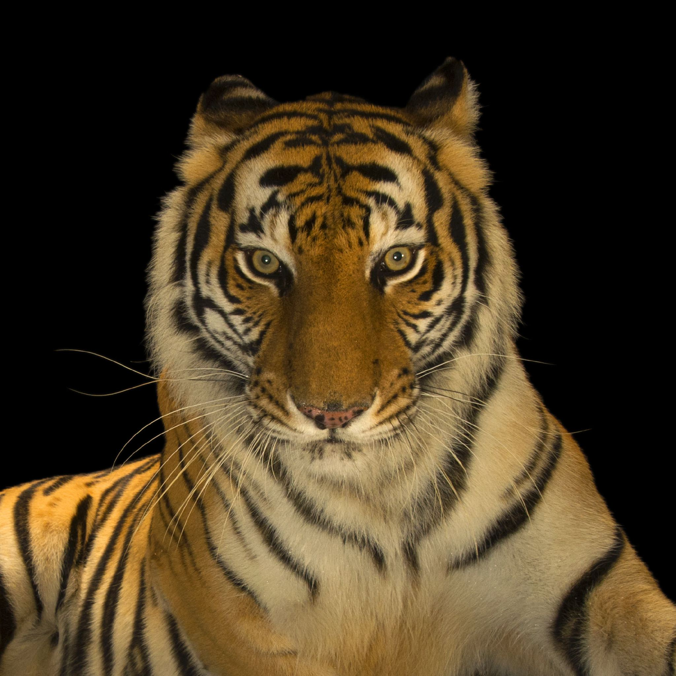
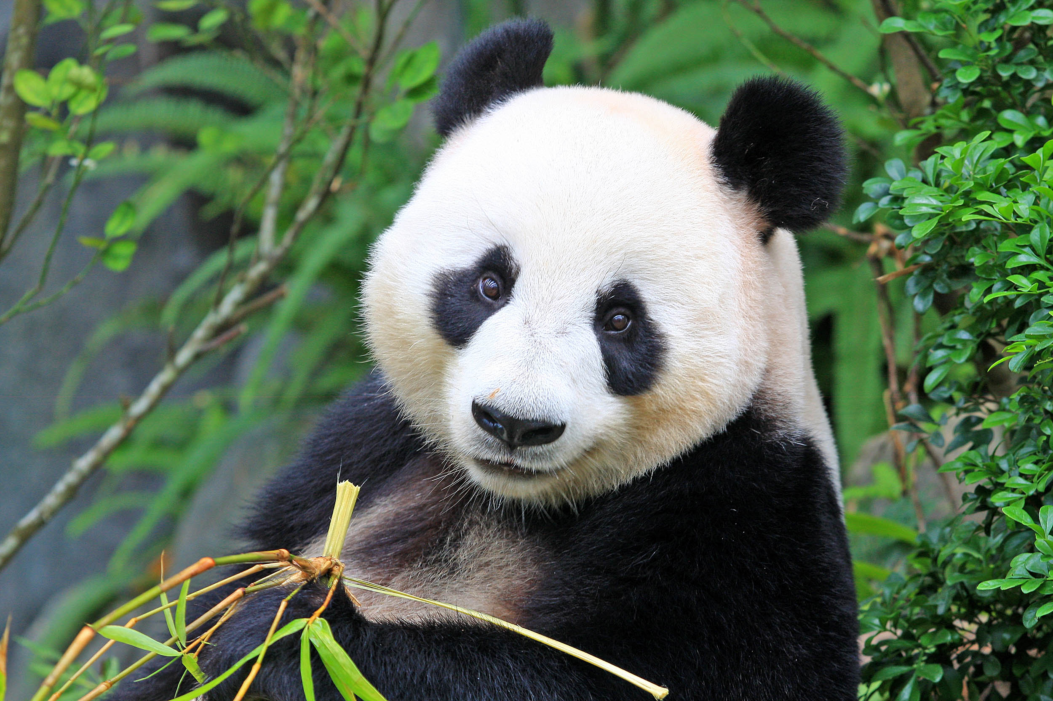
Popular Subjects of Conservation Measures
Source: National Geographic Channel
Source: Earth.org
Notes:
When asked about what animals require conservation, the answer is usually a tiger or a panda or other such popular animals. But these animals are usually not the one who are in most need of conservation. Furthermore, these animals are somewhat easier to conserve because they are easily marketable due to either their cultural importance and/or innate aesthetic appeal. This makes it easier to get funding and/or influence policy that enables their successful conservation.

Slide 5
When asked about what animals require conservation, the answer is usually a tiger or a panda or other such popular animals. But these animals are usually not the one who are in most need of conservation.
Furthermore, these animals are somewhat easier to conserve because they are easily marketable due to either their cultural importance and/or innate aesthetic appeal.
This makes it easier to get funding and/or influence policy that enables their successful conservation.

Slide 6
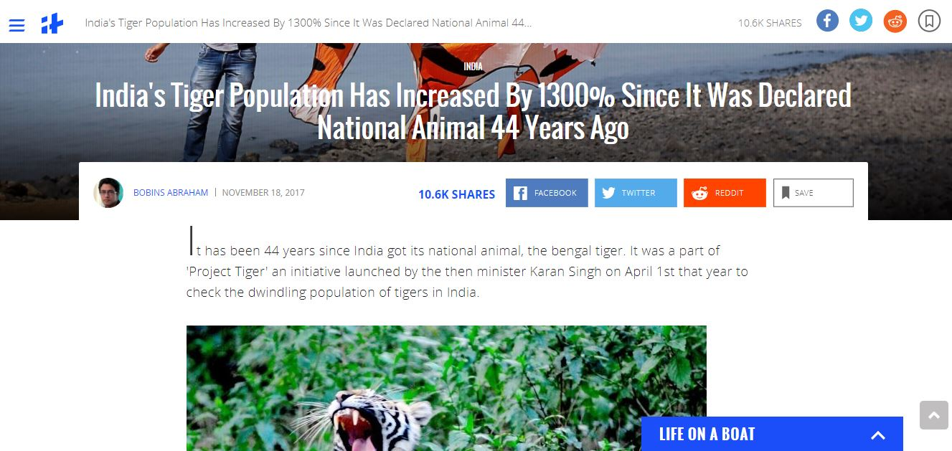
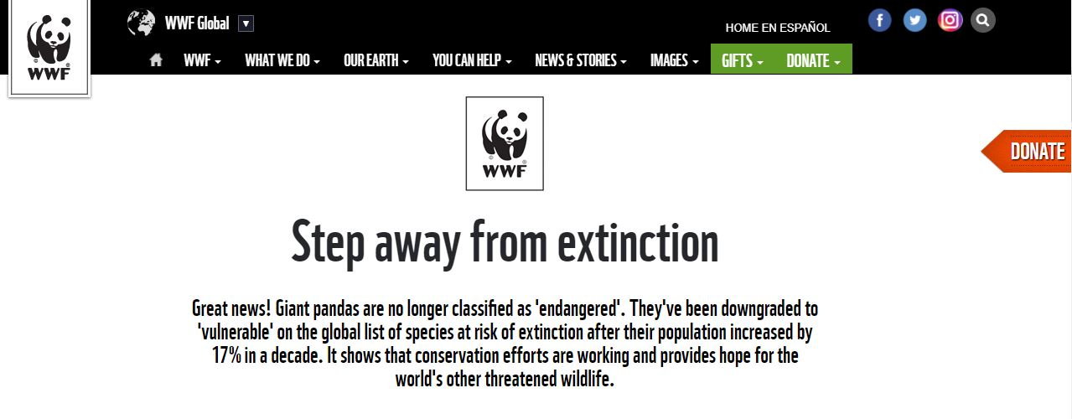
Notes:
The success of their conservation is evident in their numbers. Tiger populations have risen 1300% since it was declared as the national animal 44 years ago and Panda populations have risen 17% in a decade and is no longer listed as endangered.

Slide 7
The success of their conservation is evident in their numbers. Tiger populations have risen 1300% since it was declared as the national animal 44 years ago and Panda populations have risen 17% in a decade and is no longer listed as endangered.

Slide 8
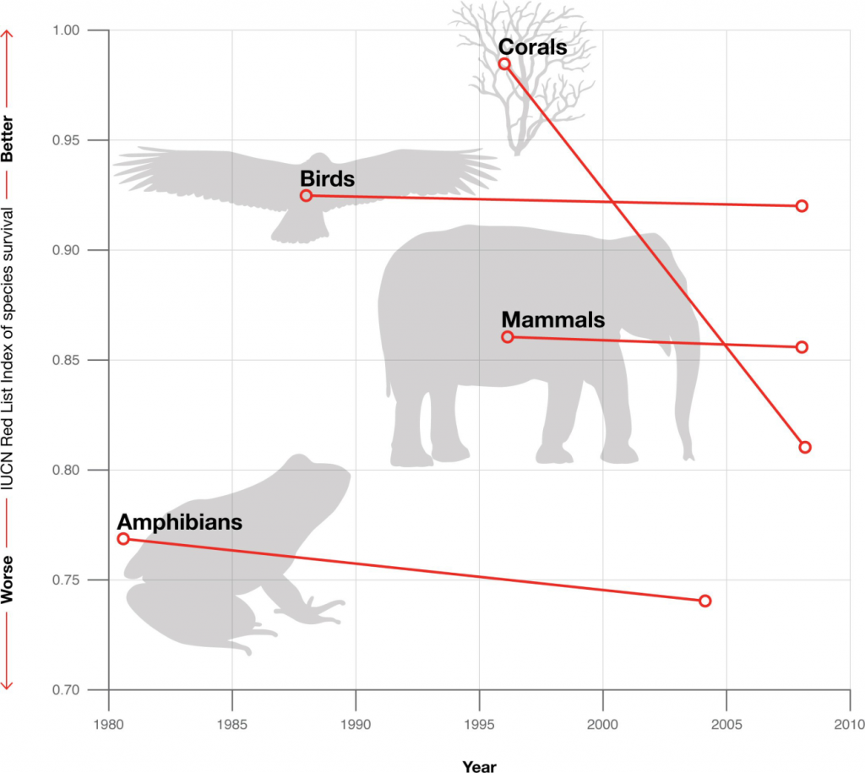
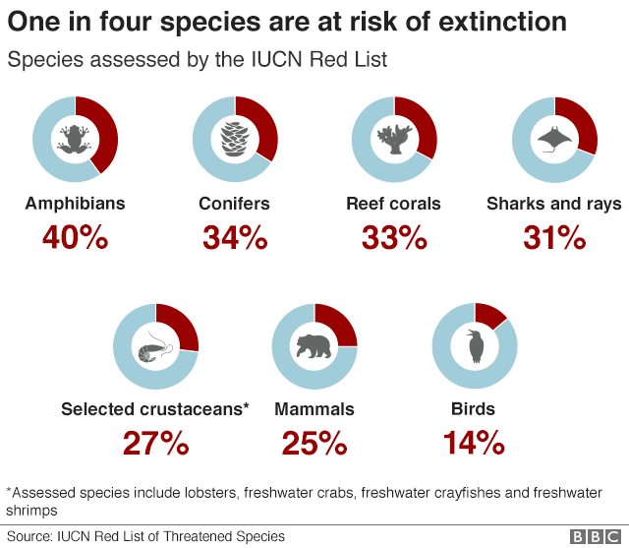
Extinction risk of various animals
Source: http://www.iucnredlist.org
Notes:
Instead, there are other animals like amphibians which are in much higher need of conservation, as can be seen from the graphics in this slide. But there in lies the problem. Animals like amphibians don’t receive adequate funding for conservation usually because of their weak cultural influence and lack of aesthetic appeal. This is a huge problem because their conservation requires specialist training and separate efforts for monitoring which requires considerable financial backing. It is also harder to influence policy for their conservation for the same aforementioned reasons.

Slide 9
Instead, there are other animals like amphibians which are in much higher need of conservation, as can be seen from the graph.
But there in lies the problem.
Animals like amphibians don’t receive adequate funding for conservation usually because of their weak cultural influence and lack of aesthetic appeal. This is a huge problem because their conservation requires specialist training and separate efforts for monitoring which requires considerable financial backing. It is also harder to influence policy for their conservation for the same aforementioned reasons.

Slide 10
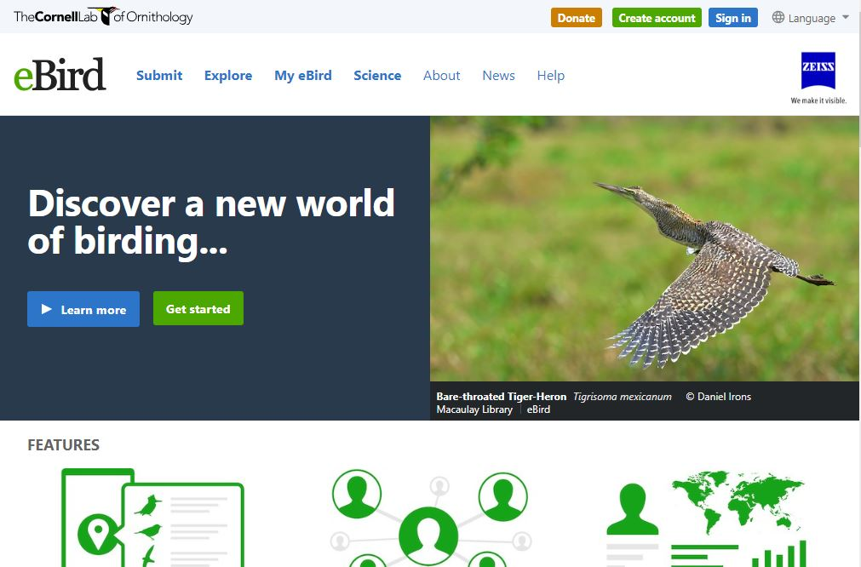
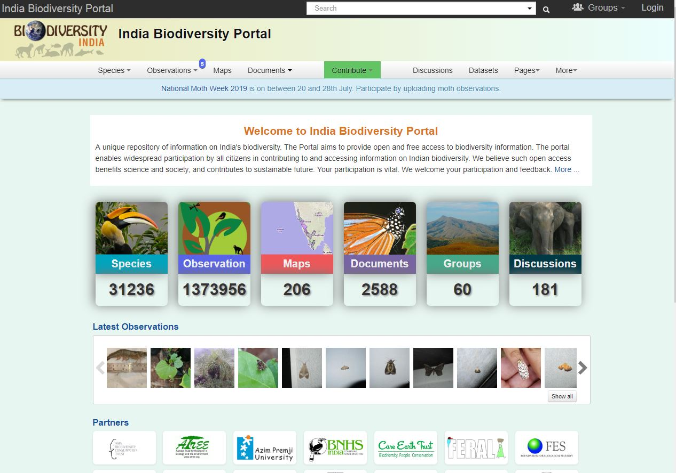
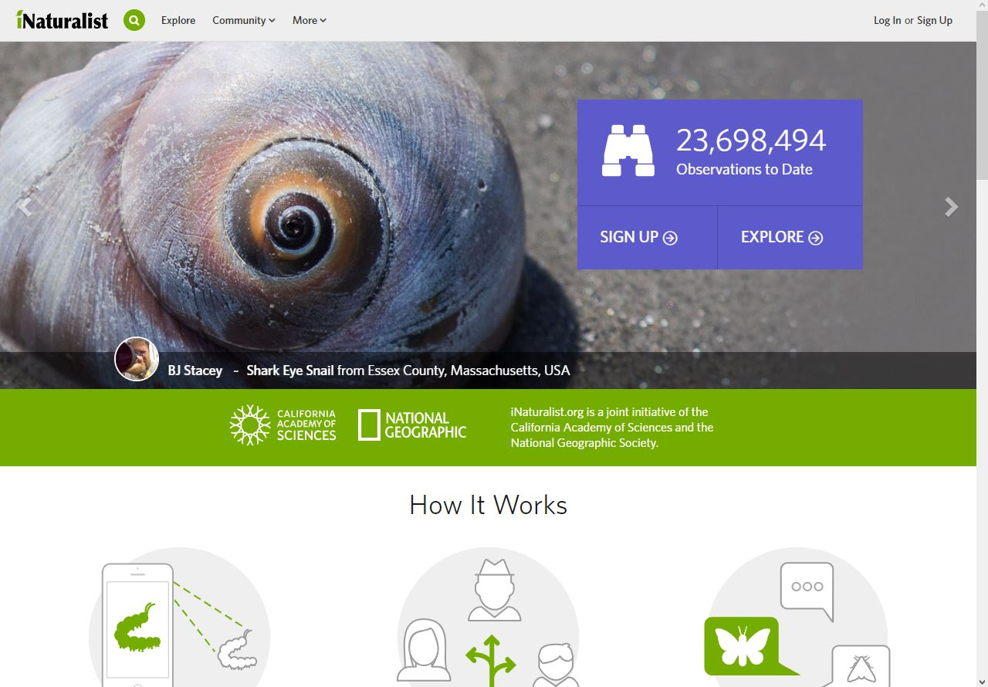
Citizen Science Initiatives
Notes:
This is where the role of technology and citizen science comes in. Citizen science initiatives are those where people even without advanced scientific training can contribute to the progress of the scientific field of their interest. It encourages people to submit their observations on various online platforms which are reviewed by experts and confirmed. This is an advantage for the hobbyists as they get their observations confirmed by an expert and also get an online database of their observations. It is also an advantage for the experts as it saves them the trouble of making these observations and get a rich dataset for next to no cost. For wildlife, ebird, inaturalist and india biodiversity portal are few of the famous ones being used in India.

Slide 11
This is where the role of technology and citizen science comes in. Citizen science initiatives are those where people even without advanced scientific training can contribute to the progress of the scientific field of their interest.
It encourages people to submit their observations on various online platforms which are reviewed by experts and confirmed. This is an advantage for the hobbyists as they get their observations confirmed by an expert and also get an online database of their observations.
It is also an advantage for the experts as it saves them the trouble of making these observations and get a rich dataset for next to no cost.
For wildlife, ebird, inaturalist and india biodiversity portal are few of the famous ones being used in India.

Slide 12
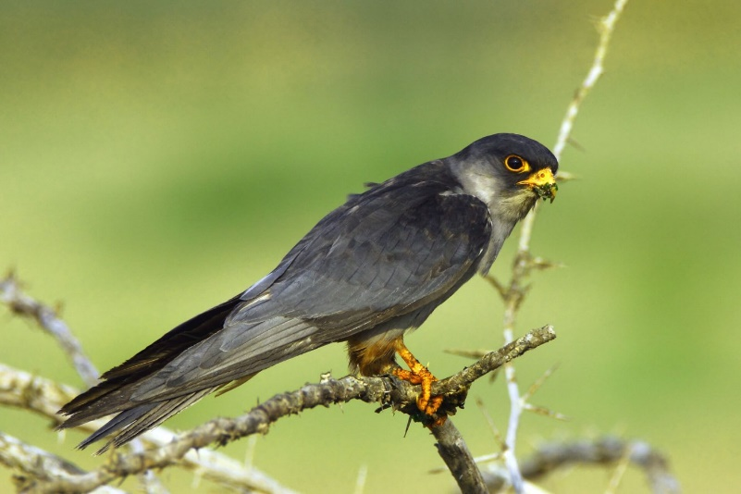
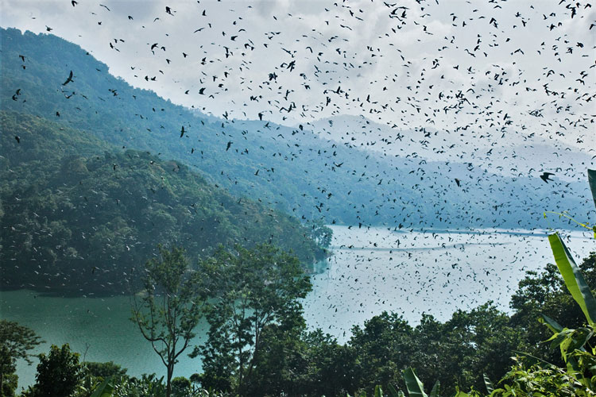
The Case of Amur Falcons
Source:conservationindia.org
Notes:
Amur Falcon is a handsome small pigeon-sized raptor. It has one of the longest migration routes in the world, covering almost 22000km in a single year. Their biggest congregation according to some estimates happens in the Wokha district of the north-eastern state of Nagaland. This entire data in this map was generated by people contributing their observations to ebird, an online citizen science portal for submitting observations of birds.

Slide 13
Amur Falcon is a small pigeon-sized raptor. It has one of the longest migration routes in the world, covering almost 22000km in a single year. Their biggest congregation according to some estimates happens in the Wokha district of the north-eastern state of Nagaland. This entire data in this map was generated by people contributing their observations to ebird, an online citizen science portal for submitting observations of birds.

Slide 14
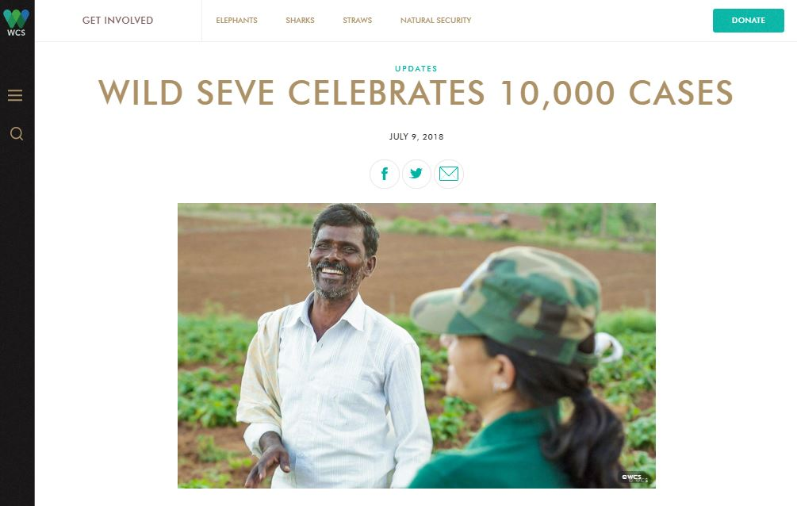
Notes:
In India, technology does not only aid in helping wildlife, but also humans. Wild seve is a mobile technology-based platform where a farmer can call a toll-free number to report a wildlife-conflict related incident. Trained personnel then physically come to help the farmer in filing compensation claims and other due processes to get fair compensation for their damage from the government. This helps the farmers be more tolerant of wildlife around them and ensure protection of the wildlife as well.

Slide 15
In India, technology does not only aid in helping wildlife, but also humans. Wild seve is a mobile technology-based platform where a farmer can call a toll-free number to report a wildlife-conflict related incident. Trained personnel then physically come to help the farmer in filing compensation claims and other due processes to get fair compensation for their damage from the government. This helps the farmers be more tolerant of wildlife around them and ensure protection of the wildlife as well.

